Slide 1



MITHABTEY - Career Seeker
Project code: 24-1-D-38
Presenters: Daniel Maman, Ben Avner Merigen
Supervisor: Dr. Naomi Unkelos Shpigel

Slide 2

MITHABTEY - Career Seeker website
Notes:
דניאל

Slide 3

The Problem Today
Many seek careers aligning with interests and skills.
Crucial for shaping future prospects.
Vast job opportunities, limited information, job offers change frequently And job world is changing rapidly.
There are professions that you do not know you may want
Notes:
דניאל

Slide 4


the Client - IRIT Hommsi Managed facebook group 'Mithabtey Miktzoa'
This Facebook community was established in 2016 and aims to reveal diverse job worlds
Facebook group with 40,000 members.
Interviews are conducted with professionals.
A large database of unique information about professions.
Status meetings on a weekly basis during the development.
Link: https://www.facebook.com/groups/612789808874188
Notes:
בן

Slide 5
Requirements
Functional requirements
Non-functional requirements
User Account Management: Registration, Login, Edit Profile
Job Search and Information: Search jobs by field Receive job information Save favorite job listings
Genetic Algorithm: Match user traits to jobs
Questionnaires and Feedback: Answer RAMAK questionnaire Give feedback on algorithm results
Job Management: Admin can add/delete/edit jobs Alerts for new jobs
Usability: Easy navigation and clear instructions Authentication: Secure login with username and password Management: Admin-exclusive job management Scalability: Handles large user base and job listings Security: Secure storage and transmission of user data Compatibility: Works on various browsers/devices Maintainability: Easy to update with clear documentation Performance: Quick loading and responsive Accessibility: Accommodates people with disabilities
Notes:
בן

Slide 6
project goals
01
02
04
03
05
organization
Admin control
Organize the data from the Facebook group
Control over the jobs in the DB, users, forums and more
Users character traits
Jobs character traits
Analysis user character traits in the best way today
Analysis character traits required for jobs
genetic algorithm
Maximum matching between character traits and possible jobs
Notes:
דניאל
לסדר את כל המידע שיש בקבוצת הפייסבוק
הנגשת קבוצת הפייסבוק ואי הסדר לאתר מסודר, נוח ונגיש למשתמשים.
ניתוח תכונות אופי של משתמש בצורה הטובה ביותר
ניתוח תכונות אופי הנדרשות למקצוע
התאמה מקסימלית בין תכונות אופי למקצועות אפשריים באמצעות אלגוריתם גנטי – לוודא תרגום של האנגלית
לתת למנהל יכולות שליטה על המקצועות באתר, משתמשים, פורומים והעלאת פוסטים
H

Slide 7

how we implemented our goals
Analyzed user traits using the RAMAK questionnaire
Created a jobs collection to organize data received from our client
Implemented a genetic algorithm

Slide 8
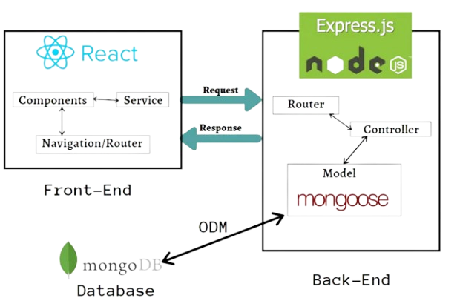




System architecture
MERN
React
Typescript
Front-End
Program language
Node.js
Mongodb
Back-End
NoSQL DataBase
Notes:
דניאל

Slide 9




Central points in development
JWT
Google API
Encryption of sensitive information
Fast website authentication
Tailwind css
Nodemailer
Dynamic design
API for sending emails
Notes:
דניאל
Google API
JWT
Tailwind css
Mailer - reset paswword

Slide 10


Genetic Algorithm overview
Optimization algorithms inspired by natural selection.
Used for finding optimal solutions to complex problems.
Mimics evolution with processes like selection, crossover, and mutation.
Individuals represented as sets of parameters or genes.
Evaluated using fitness function.
Notes:
בן

Slide 11
Genetic Algorithm Matching between user`s traits And job`s traits
It is necessary to fill out an initial questionnaire.
The questionnaire will characterize the user.
The information will be sent to the genetic algorithm.
A match will be made against the full database of professions.
The user will receive an answer of the three twin subjects for him the most
Notes:
בן

Slide 12
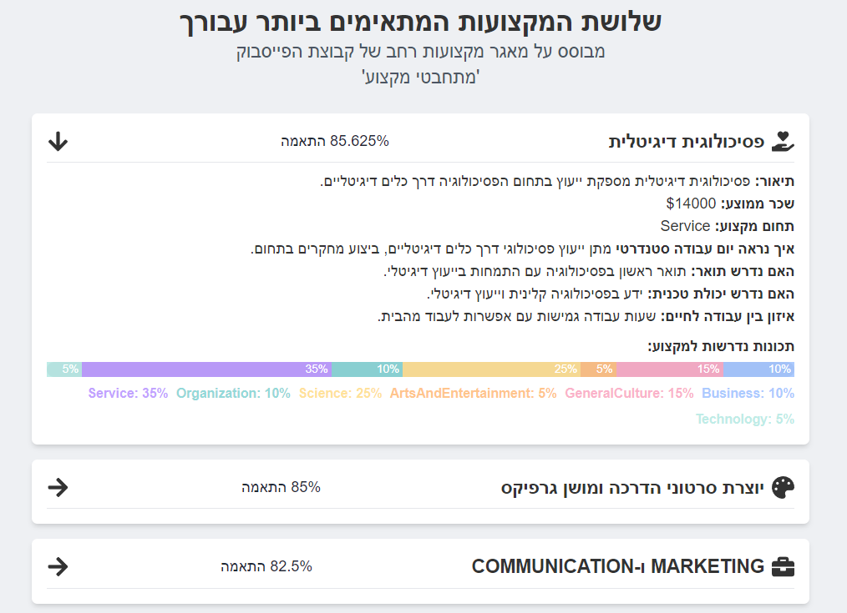

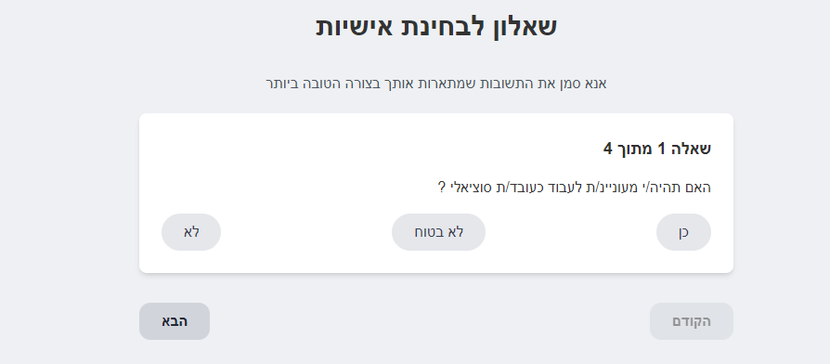
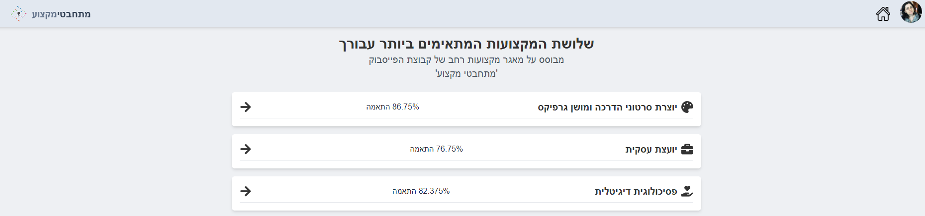
Genetic Algorithm Matching between user`s traits And job`s traits
Notes:
בן

Slide 13
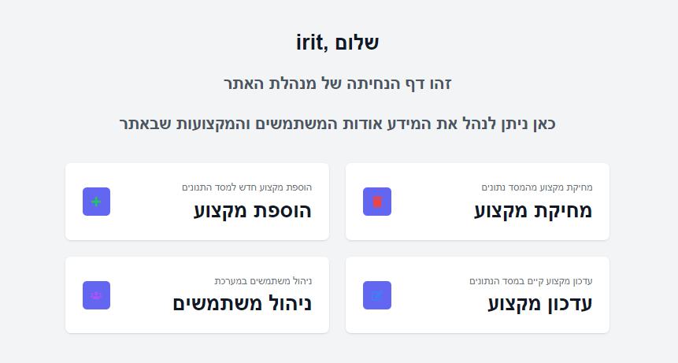
Admin panel
Convenient interface for the manager
Options for switching between actions
Option to manage permissions for users to facilitate the administrator's processes

Slide 14
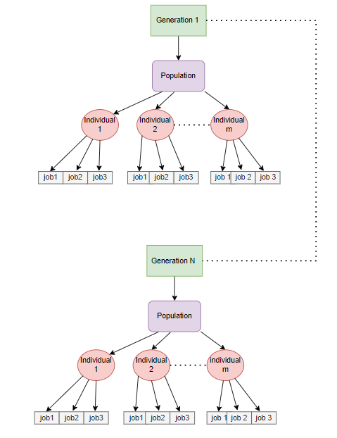
Genetic Algorithm generation, population, INDIVIDUAL
Individual is a list of 3 random professions.
The population will be a list of predetermined size of individuals.
In each generation we have a new list of population (some of them remain from the previous generation).
Notes:
בן

Slide 15
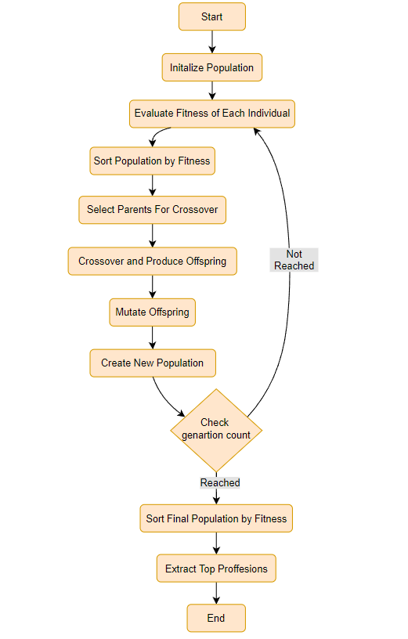
Genetic Algorithm Flow
The 3 main processes in the genetic algorithm:
Random initialization
Loop that repeats N generations
Finishing and getting the best results.
Notes:
דניאל

Slide 16
Genetic Algorithm Inside the loop
Fitness - Representing how well an individual suit to user.
Selection - Roulette wheel: more suitable individuals will be chosen with a higher probability- select 2 parents.
Crossover - Exchange between 2 parents, in split point to create new childrens.
Mutate - Changing an individual's job randomly.
Notes:
דניאל

Slide 17
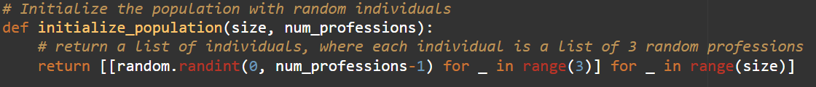

Genetic Algorithm Random initialization
We will define a list of initial population.
The population size will be a predetermined number.
Each individual in the list will consist of 3 random professions.
Notes:
אתחול ראשוני רנדומלי
לולאה שחוזרת N דורות
סיום וקבלת התוצאות הטובות ביותר

Slide 18
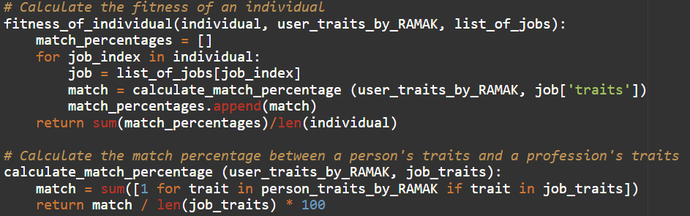
Genetic Algorithm Fitness
Represents how well an individual in the population solves the problem.
The function calculates the fitness of each individual by measuring the match percentage between the person's traits and the traits required for each of the professions in the individual's list.
This fitness score guides the selection process in the genetic algorithm, favoring individuals with higher fitness scores.
Notes:
מידול של Fitness function המטרה - כמה תכונות מהמקצוע נמצאות אצלי Trait U = 1 Trait P = 1 2
=> בדוגמא למעלה יש לי תכונה אחת מתאימה מתוך 2 ולכן אני דומה ב 50 אחוז

Slide 19
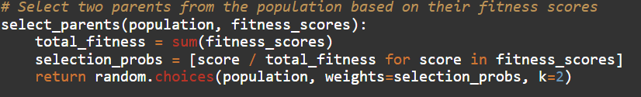
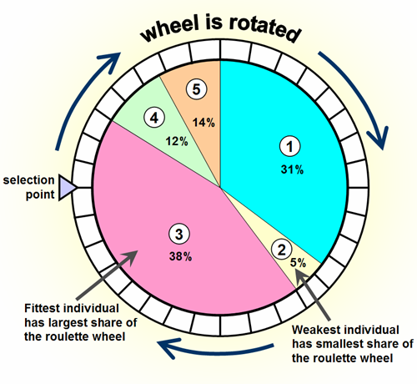
Genetic Algorithm Selection
Stochastically select from one generation to create the basis of the next generation.
The requirement is that the fittest individuals have a greater chance of survival than weaker ones.
Implements selection using a method called roulette wheel selection.
Notes:
החלק הבסיסי בתהליך הבחירה הוא בחירה סטוכסטית מדור אחד כדי ליצור את הבסיס לדור הבא. הדרישה היא שלאנשים הכי חזקים יש סיכוי גדול יותר לשרוד מאשר לחלשים יותר. זה משכפל את הטבע בכך שלפרטים בכושר יש סיכוי טוב יותר להישרדות והם ימשיכו להרכיב את מאגר ההזדווגות לדור הבא. אנשים חלשים יותר אינם חסרי סיכוי. בטבע לאנשים כאלה יש קידוד גנטי שעשוי להיות שימושי לדורות הבאים.

Slide 20
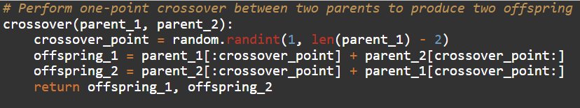
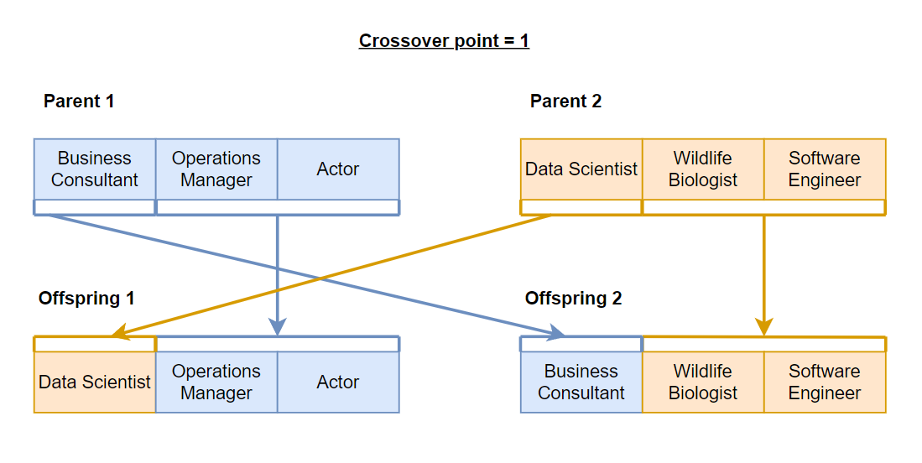
Genetic Algorithm Crossover
Randomly selects crossover point along parents' ‘chromosomes’.
Creates two offspring by combining parents' genetic information
The function randomly selects a crossover point.
This process helps maintain genetic diversity in the population and can lead to the discovery of new, potentially better solutions to the problem.
Notes:
מידול של Crossover

Slide 21
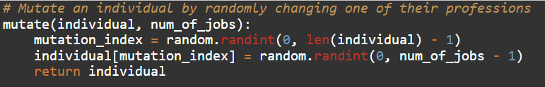
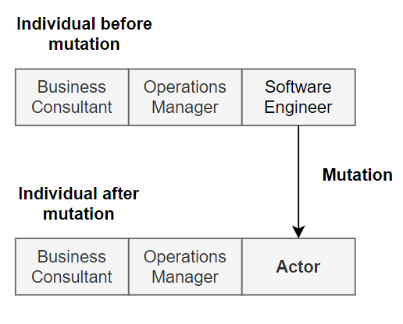
Genetic Algorithm Mutation
The function implements mutation by randomly changing one of the professions in an individual.
Ensures each generation has genetic diversity.
Crucial for exploring a wide range of potential solutions and finding optimal/near-optimal solutions.
Notes:
מידול של Mutation

Slide 22
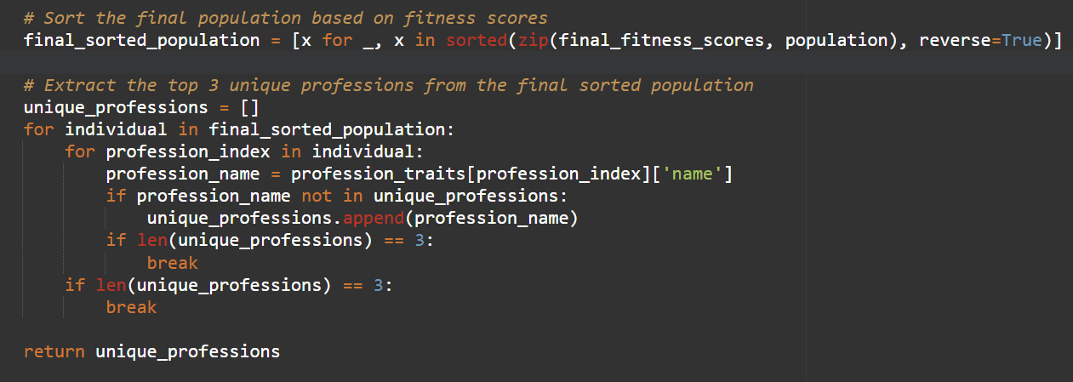
Genetic Algorithm Extract most suit professions
We will take the last population created and sort it by match percentage from largest to smallest.
We will take the first three most suitable professions that are different from each other.

Slide 23


Project metrics
Comprehensive Evaluation System
Targets and Continuous Improvement
Intermittent User Surveys:
Surveys to evaluate satisfaction with algorithm answers and RAMAK questionnaire.
Genetic Algorithm Validation:
Verification of results with people who are works in the jobs.
Analysis the final answers with employment psychologists.
Follow up over time:
Updates from users on career progression.
User Growth Targets:
Anticipate 30% increase in user registrations within the first three months.
Surveys and Polls:
Create surveys and polls within the 'MITHABTEY' Facebook group. At least 60% of respondents to recommend the site.
80% of users want to reuse the site for career guidance.
Notes:
בן

Slide 24
The challenges during the development
01
02
03
04
Changes during development
Psychological research
A code change affected additional components
Characterization of professions according to required character traits
Working with client
budget
Done for the first time, requires patience and mental flexibility.
More efficient components require a larger budget
Notes:
דניאל

Slide 25

The product
Notes:
סרטון

Slide 26


THANKS for listening!
QUESTIONS ?
https://github.com/MamanDaniel/MITHABTEY-CareerSeekers
Link to website

